Slide 1
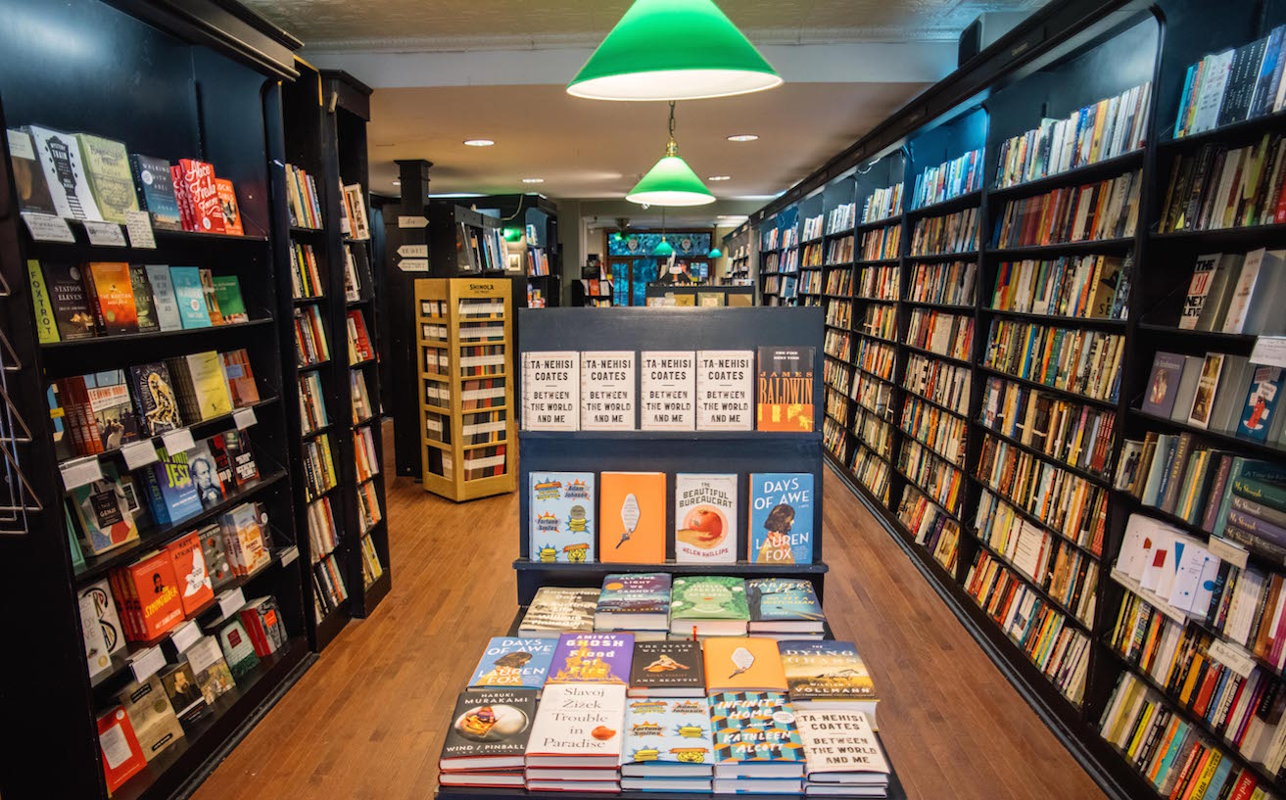
THE BOOK PROPOSAL

Slide 2
The proposal should demonstrate:
You have a compelling idea for a book.
That compelling idea requires a book-length treatment (35k+ words).
There is an audience for this compelling, book-length work.
You are the perfect person to bring this project into the world.

Slide 3
Proposal Checklist
Overview
Synopsis
Chapter Outline
Author Bio & Platform
Comp Titles & Target Audience
Marketing Plan
Sample Chapters

Slide 4
Proposal Checklist
Overview
“What will excite editors who have seen thousands of proposals? You’re not selling just your book, you’re selling yourself.”
“You must convince editors that your subject warrants a book. Try to make your hook grab readers the way the lead paragraph in a magazine story does.”

Slide 5
Samples of strong overview lines:
Empty Mansions: The Mysterious Life of Huguette Clark and the Spending of a Great American Fortune by Bill Dedman and Paul Clark Newell, Jr.
A portrait of over-the-top wealth and a haunting story of reclusive American heiress Huguette Clark. Her fascinating story--and the colorful past of the now infamous W. A. Clark family—are told by Pulitzer Prize-winning journalist Bill Dedman and Huguette's cousin, Paul Clark Newell Jr., who reveal new and surprising information.
Sous Chef: 24 Hours on the Line by Michael Gibney
For fans of Heat and Kitchen Confidential comes an intense and unflinching twenty-four-hour cycle in the life of a sous chef, from an up-and-coming literary talent and fifteen-year veteran of New York restaurant kitchens.

Slide 6
Proposal Checklist
Synopsis
Essential information (title, selling handle)
Comp titles/models
Word count + illustrations
Delivery schedule
Optional: Major benefits Special features (sidebars, exercises, etc.)
Notes:
In your synopsis, you highlight what your book is about, why it’s important at the moment, and why you feel compelled to tell this story
More than a synopsis about your plot, this is a synopsis of the project you’re proposing.
After you hook editors to your subject, the next challenge is to ensnare them with the essential information about your book: The title and the selling handle for your book.
The books or authors serving as models for your book.
The expected (or actual) word count of your manuscript (and the number of illustrations, if you use them)
How many months after receiving your advance you will deliver your manuscript.
An optional list of your book’s major benefits
Optional: special features: anecdotes, humor, checklists, sidebars, exercises, summaries, boxed copy, icons, and anything else you will do to give you book visual appeal, links to Web content, back matter, and anything else you will do to make your book visually appealing and useful.
(Optional) If you’ve self-published your book, tell editors whatever will help sell it. Include sales figures and information about subsidiary-rights sales. a list of changes, if any, you want to make in the new edition. how many manuscript pages of new material you will add, if any. the number of months after signing you will deliver the manuscript. Include reviews and articles about the book with key passages underlined.

Slide 7
Proposal Checklist
Chapter Outline
Sample Chapters

Slide 8
Proposal Checklist
Author Bio & Platform
“The author’s
platform: A list of whatever will impress editors about your visibility to your readers.”
Notes:
Author Bio
You know what this is—and as journalists probably already have one.
100 – 300 words (100-word version would be on the book jacket; 300-word version could be on your ATA page, if warranted; it’s really what people would read to introduce you at book signings and panels and the like.) If it’s substantive (and not fluff, or info that would be better off bulleted and listed as part of your platform), you can go for the 300-word version in your proposal.
Author Platform
And all that stuff you’d list in your bio? That’s your platform.
Michael Larsen says—CLICK/READ QUOTE.
It's not just to impress editors; it's to help them--and the sales teams that will use this to pitch your book to retailers. It’s to help the publicity and marketing teams that will promote your book to consumers to know where to go first.
By offering you an advance, your publisher is betting she can sell a certain number of copies of your book. The size of your platform is a critical tool in making that bet. It's why you hear of such lofty advances for some celebrity books that may lack literary heft. A reality show star or You Tube sensation can evidence a built-in fan base--even if only 10% of their social followers buy the book, that could be 50k-200k copies sold for some.

Slide 10
Proposal Checklist
Marketing Plan
“A plan (listed in descending order of impressiveness) describing what you will do to promote your book, online and off, during its crucial one-to-three-month launch window and after. Publishers won’t expect big plans from memoirists, and the smaller the house you’ll be happy with, the less important your platform and plan.”

Slide 11
Proposal Checklist
Comp Titles & Target Audience
Competitive
Comparative
Complementary
Notes:
Competing books: A list of the ten or so strongest competitors for your book — not just bestsellers.

Slide 12
Comp Titles
TITLE by Author (Publisher, pub year; page count (format) | price | ISBN)
“This book about ###, like mine, discusses ###. However, for the first time, my project details ###.”
Notes:
In addition to basic info about each book (title, author, publisher, year of publication, page count, format, price, ISBN), include two phrases — each starting with a verb — about each competitor’s strengths and weaknesses. List the competitors in order of importance.

Slide 13
Proposal Checklist
Comp Titles & Target Audience
What group(s) of people did you have in mind when writing?
Who are the people most likely to invest their money, time, and attention in your book?
Notes:
TARGET AUDIENCE: How Book People Talk About Audience
What group(s) of people (demographic, regional, interests/genre) did you have in mind when writing? Who are the people most likely to invest their money, time, and attention in your book?

Slide 14
Target Audience
Fans of biographies, historical dramas, real estate, and art
Readers of narrative nonfiction like Between the World and Me
Readers interested in politics, current affairs, and culture
Viewers of PBS’s “American Masters” series
Notes:
Here are a few examples of the language agents, editors, publishers, marketers, publicists, sales reps, and book sellers use when talking about audience

Slide 15
Target Audience
Outsized new talent: This is an ambitious, beautifully executed narrative, and Margaret deserves comparison to Susan Orlean, Tracy Kidder, and Adrian Nicole LeBlanc.
Supremely well-connected author: Margaret is a hub of literary activity, with articles everywhere from Popular Science to the Huffington Post. She is a large presence on Twitter and Facebook, appears on NPR and Pod Save the People, and maintains a popular blog at medhistory.com.
Notes:
Here are a few examples of the language agents, editors, publishers, marketers, publicists, sales reps, and book sellers use when talking about audience

Slide 16
Target Audience
For readers of Charles Duhigg's The Power of Habit, Chip & Dan Heath's Switch, and Ed Catmull's Creativity, Inc.
For readers of idea and anecdote-driven books on leadership, performance, management, and innovation
For the 220k readers of Daniel Coyle's The Talent Code and the 60k readers of The Little Book of Talent
For readers interested in leadership, teambuilding, and management categories, and also transcend those categories by providing readers with a new way to think about unlocking their group's potential
Notes:
Here are a few examples of the language agents, editors, publishers, marketers, publicists, sales reps, and book sellers use when talking about audience

Slide 17
Proposal Checklist
Overview
Synopsis
Chapter Outline
Author Bio & Platform
Comp Titles & Target Audience
Marketing Plan
Sample Chapters

